Slide 1
A QUickLook Determination of Oil-in-place in Oil Shale Resource plays
Marlan W. Downey, Julie Garvin, RC Lagomarsino, David F. Nicklin

Slide 2
Acknowledgements:
Roxanna Oil and Gas Company
  Eddie Little
Matador Resources Company
  Anne Lindsey McColloch
  Justin Bagley
  Bo Henk

Slide 3
Discussion Topics
Gas-in-place measurements in the Coal and Shale Gas Industry
  Gas desorption methodology
Importance of Hydrocarbon Target Volumes in Unconventional Resource Plays
  Measure amount of Hydrocarbons available
  Application of RockEval Pyrolysis for S1 values

Slide 4
Gas Desorption Methodology
Standard analytical technique over 20 years
  Measures total gas contained in coal cores or shale cores.
  Allows the determination of the total gas resource in place in a given area.

Slide 5
Hydrocarbon Target Volumes
Focus on application of hydrocarbon distillation from Rock-Eval.
  Requires rock samples, preferably whole core, properly collected.
  Determines volumes of distillable hydrocarbons in the rock in mg of hydrocarbon/g of dry rock.
  Relatively simple and cheap to do.
  Results can be obtained early in exploration campaign.
  Easily up-scaled to reflect total rock potential.

Slide 6
Hydrocarbon Target Volumes
Emphasis on S1 measurement of distillable hydrocarbons.

Slide 7
Rock Eval Pyrolysis
S1 represents the free hydrocarbons in a rock
  Primarily indicates generated free oil (liquid hydrocarbons)
  The greater the S1 value, the greater amount of free oil
  Optimum data from whole core
S2 Peak
Pyrolysis of kerogen
(nonvolatile organic matter)
Tmax
S1 Peak
Volatilization of existing HC
Potential Oil
Existing Oil
TEMPERATURE
TIME

Slide 8
APPLICATION ProceDURE
Establish S1 values, preferably from whole core, preferably every foot. This represents measured oil-in-place per unit volume of rock.
Upscale oil-in-place to Acre-feet or “Section-feet” (i.e. one square mile of surface area x one foot thick x hydrocarbon richness).
Resulting volume from core measurements is a minimum value for the oil-in-place volume.

Slide 9
Methodology: Oil in Place from S1
Step 1: grams of oil per section
M_{S1HC}= Ah (ρ_{Av}) (S1_{Av})(.001) ÷ 8.11E-10 acre-ft/cc
Where:
M_{S1HC} = Mass of S1 hydrocarbons per section (g)
A = Area of interest in acres (sectional area – 640 acres)
h = Reservoir height (ft)
ρ_{Av} = Average bulk density (g/cc)
S1_{Av} =Average S1 (mg/g)

Slide 10
Methodology (cont.)
Step 2: volume of oil per section (cc)
V_{S1HC} = M_{S1HC} ÷ ρ_{oil}
Where:
V_{S1HC} = Volume of S1 hydrocarbons per section (cc)
M_{S1HC} = Mass of S1 hydrocarbons per section (g)
ρ_{oil} = Density of oil (g/cc)

Slide 11
Methodology (cont.)
Step 3: barrels of oil per section
Oil in Place per section (Bbl)
=
V_{S1HC} x 6.29E-6 bbl/cc

Slide 12
Oil in Place from S1
Simplified Equation
Oil in Place per 640 acre/ft = 4965.36 x (ρ_{Av}) (S1_{Av})/(ρ_{oil})
Where:
ρ_{Av} = Average bulk density (g/cc)
S1_{Av} =Average S1 (mg/g)
ρ_{oil} = Density of oil (g/cc)

Slide 13
Oil in Place from S1
Simplified Equation
Oil in Place per 640 acre/ft = 15922.78 x (S1_{Av})
Where:
S1_{Av} =Average S1 (mg/g)
  Assumes:
  2.5 g/cc Bulk Density
  50º API Oil Gravity

Slide 14
Conversions
1 section = 640 Acres
1 cc = 8.10713194 E-10 Acre-ft
1 cc = 6.28981077E-6 Bbl
Specific gravity = 141.5/(131.5 + API gravity)
Specific gravity 1 =1 g/cc
1 mg = .001 g

Slide 15
Quicklook Conversion of S1 to Oil
Using S1 in mg/g to BBL of Oil in 640 acres/foot
72,000
4.0
56,000
S1
MG/G
3.0
BBL/FT
(Min. Target Vol.)
40,000
2.0
24,000
1.0
(R.C. Lagomarsino)
8,000
0.0
Assumes:
2.5 g/cc Bulk Density
50º API Oil Gravity

Slide 16
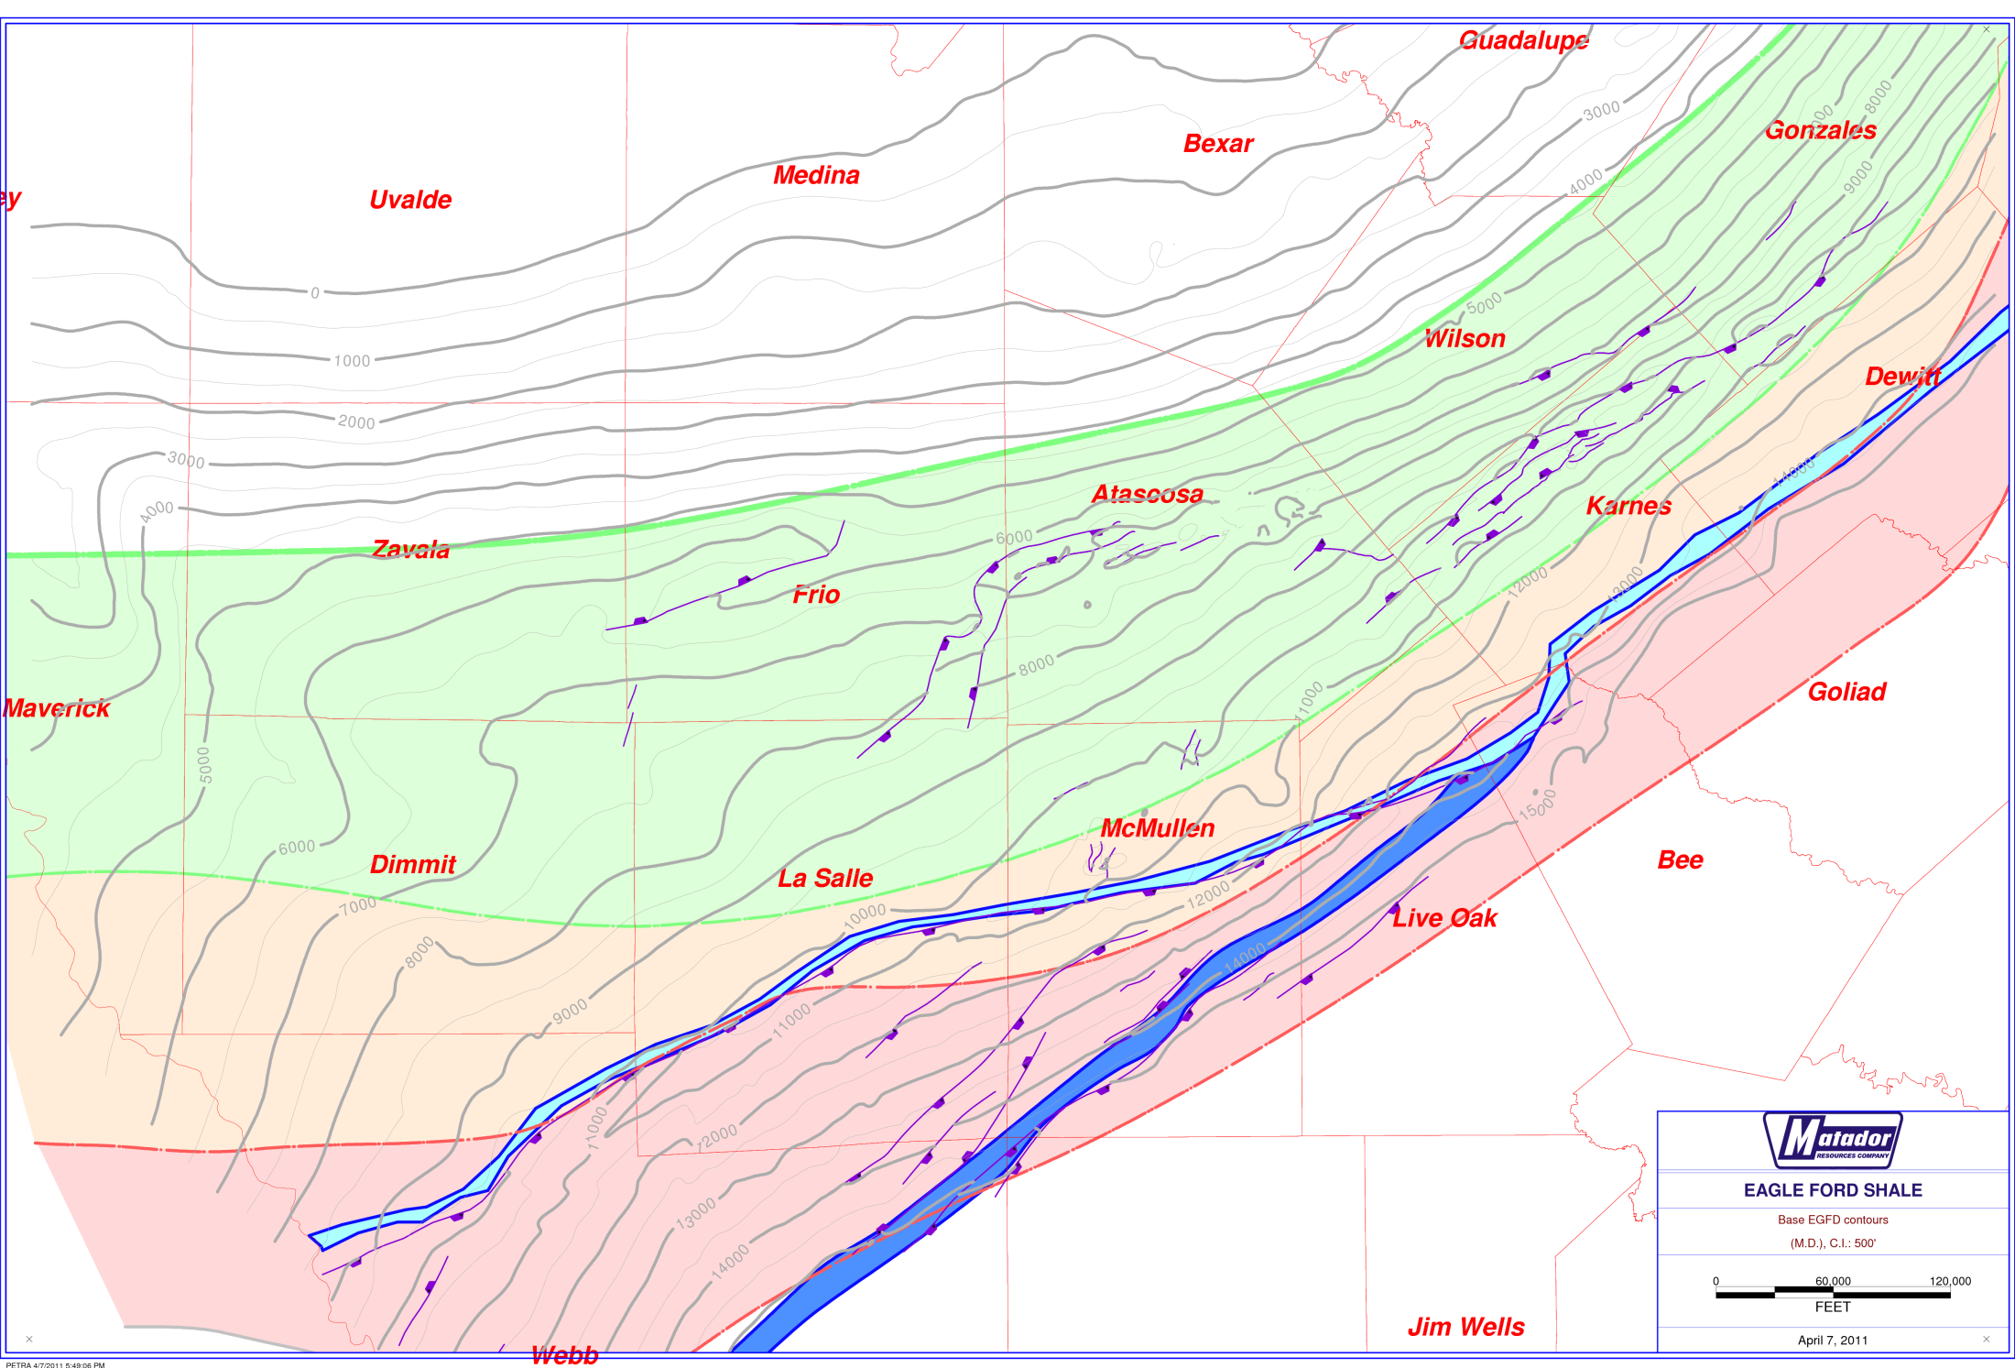
Eagle Ford Shale – STUDY Wells
Well ‘A’
Well ‘B’
OIL FAIRWAY
COMBO
LIQUIDS/GAS
FAIRWAY
DRY GAS FAIRWAY

Slide 17
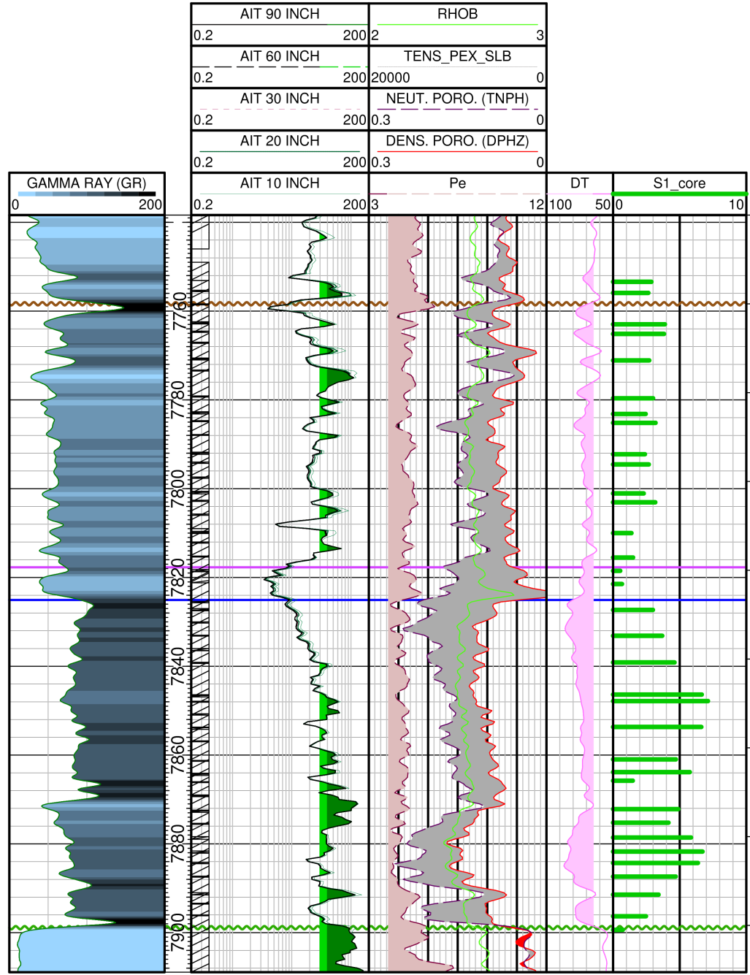
Vertical Variations in S1 Values for Eagle Ford, Well ‘A’
(Less Thermally Mature)
Average S1 = 3.55 g/mg
56.525 MBBL/640 ac/ft
Weighted Avg. = 11.0
MMBBL/640 Ac.
(Min. Target Vol.)

Slide 18
Eagle Ford Shale – STUDY Wells
Well ‘A’
Well ‘B’
OIL FAIRWAY
COMBO
LIQUIDS/GAS
FAIRWAY
DRY GAS FAIRWAY

Slide 19
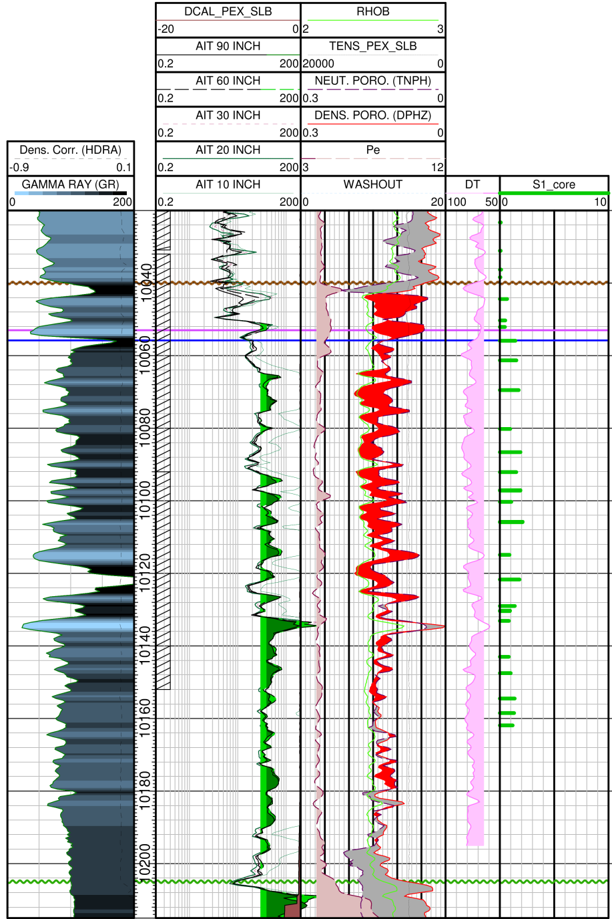
Vertical Variations in S1 Values for Eagle Ford, Well ‘B’
(More Thermally Mature)
Average S1 = 1.86 g/mg
29.616 MBBL/640 ac/ft
Weighted Avg. = 4.0
MMBBL/640 Ac.
(Min. Target Vol.)

Slide 20
Conclusions
Rock-Eval S1 value provides early measurement of oil in place.
Can be up-scaled easily for various thicknesses for quantified values of oil-in-place.
Measurements of oil-in-place compared to production decline analysis will provide improved measures of recovery efficiency.
For further information, check out:
www.roxannaoil.com

